Slide 1
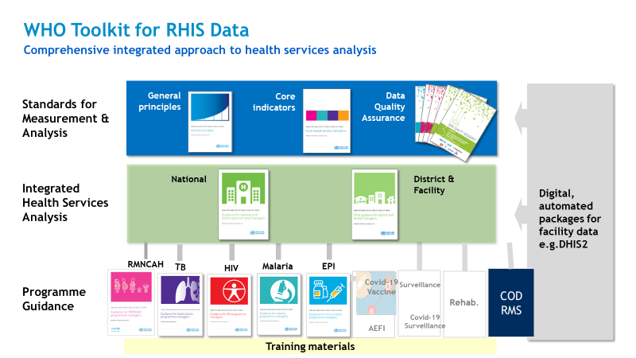
https://www.who.int/data/data-collection-tools/health-service-data/toolkit-for-routine-health-information-system-data/modules

