Slide 1
Archive of RHIS global goods: an initial product of the HDC RHIS Working Group
Theo Lippeveld, Jean-Pierre de Lamalle, Ahn Chu, Rifat Hossain,
Derek Kunaka, Remy Mwamba, Bob Pond and Wendy Venter
Notes:
The archive of RHIS global goods is an initial product of the HDC RHIS Working Group. A sub-group, with members listed here, has gotten the process started.

Slide 2
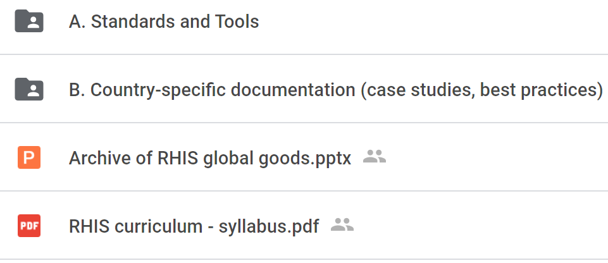
An online repository of RHIS global goods: https://drive.google.com/drive/folders/1eH6kzywasJM3uLZOxVEb1NKzUpmlLfbb?usp=sharing
Notes:
The archive, is an online repository accessible so far to all members of the RHIS Working Group. Please let me (Bob Pond) know if you have any difficulty accessing it.
The global goods consist of documents of three types:
Global standards for RHIS;
Tools for supporting implementation of these standards; and
Country-specific examples and best practices.
As you see, the syllabus of the RHIS curriculum is found in the root directory.

Slide 3
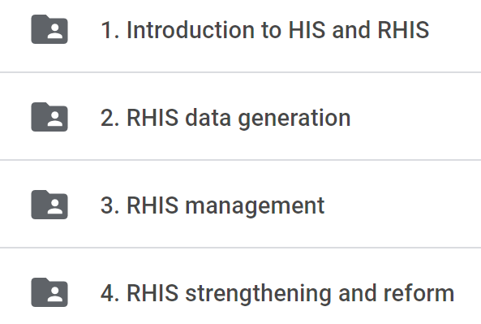
Largely based on the RHIS Curriculum: https://www.measureevaluation.org/resources/publications/sr-16-135b.html
Notes:
The sub-group began by agreeing that the outline of this course provided a logical and comprehensive way of organizing RHIS standards. Moreover, the documents cited by this course continue to serve as authoritative references. So we began by uploading these documents into the archive – using updated versions where appropriate.
The slide shows the subfolders of the Standards folder. I will quickly review the contents of each of these subfolders.

Slide 4
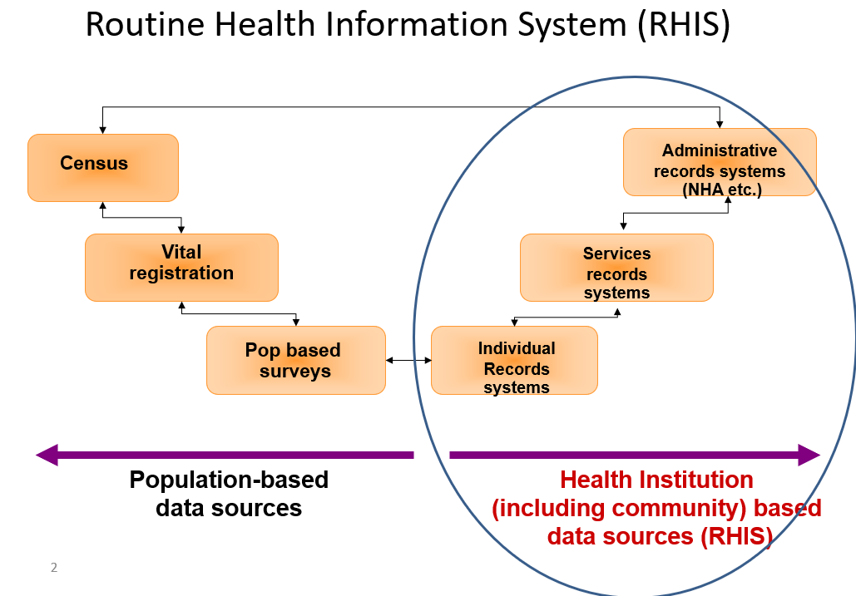
1. Introduction to HIS and RHIS
Notes:
This sub-folder consists of documentation which defines the RHIS and its relationship to the overall health information system

Slide 5
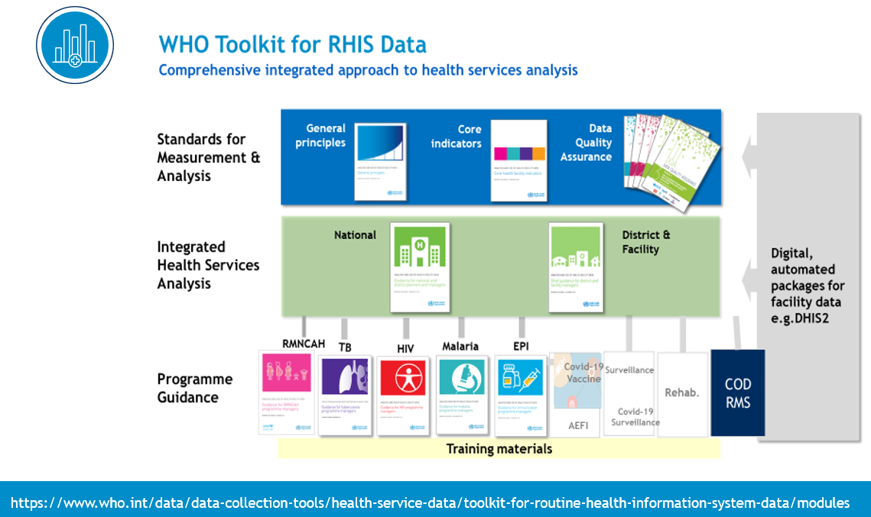
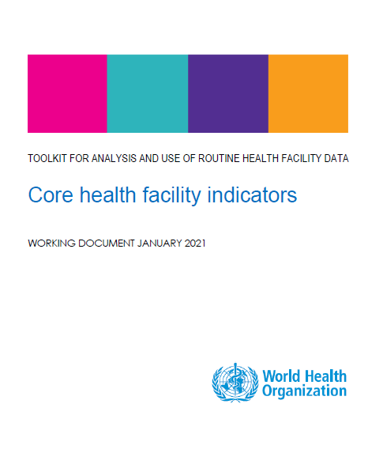
2. RHIS data generation
2a -- Data needs, indicators, data collection and reporting
2b – Data management
2c – Data quality
2d – Data visualization, analysis & interpretation
2e – Data demand and use
Notes:
These sub-folders contain key documentation of standards for
Data needs, indicators, data collection and reporting
Data management – meaning data transmission, storage and processing
Data quality looks at assessment and assurance of data quality
Data visualization, analysis and interpretation
Data demand and use
Here you see the cover pages of some key documentation on these topics.

Slide 6
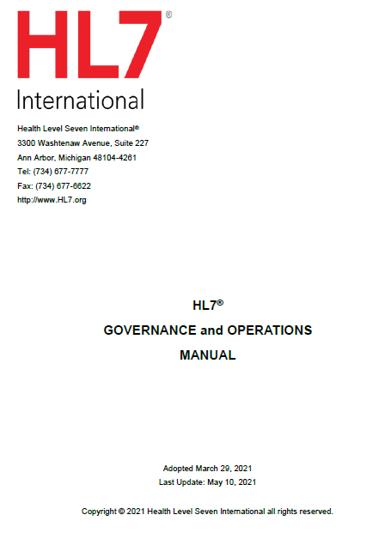
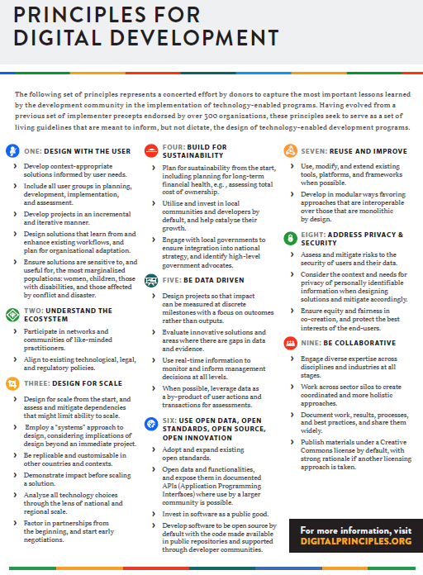
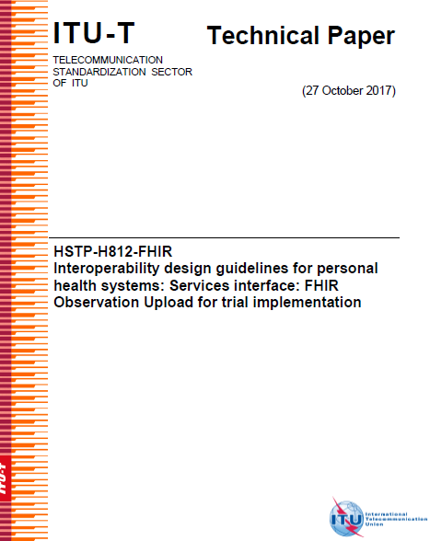
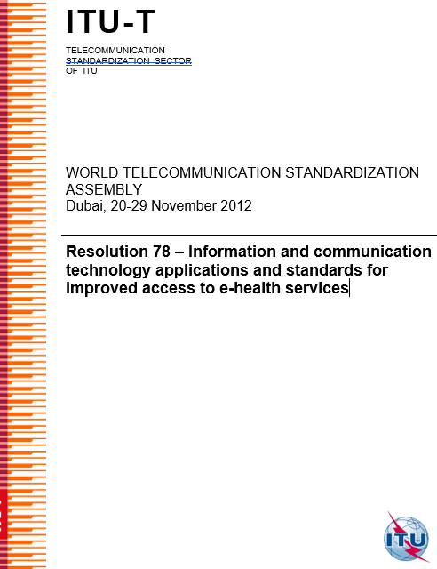
3. RHIS management
3a – Governance and management of RHIS resources
3b – Information and communication technology
Notes:
The third set of sub-folders includes documentation defining standards for
Governance and management of the RHIS; and
Information and communication technology

Slide 7
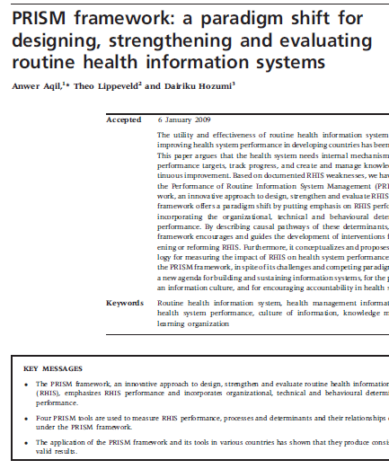
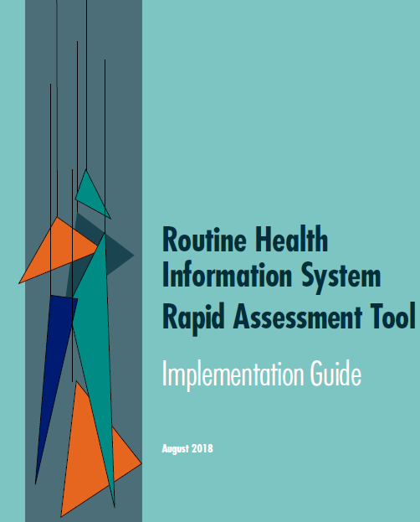
4. RHIS design and reform
4a – RHIS assessment
4b – RHIS design and reform
Notes:
Finally, there are standards for
RHIS assessment; and
RHIS design and reform
This slide includes a couple of now rare sightings: the HMN Framework document and the so-called “blue book” which set standards for joint annual reviews at national level

Slide 8
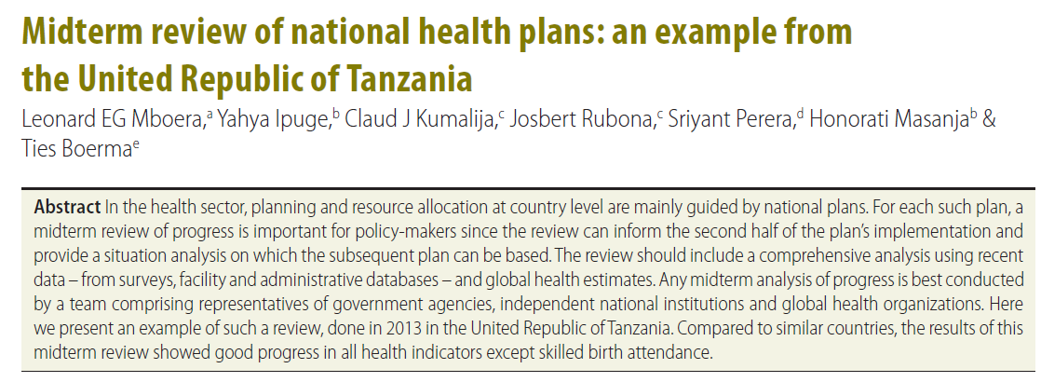
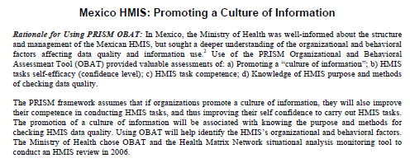
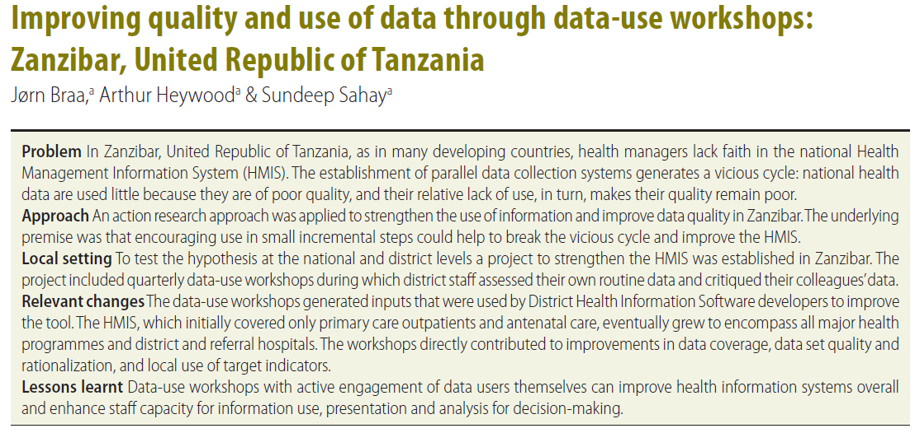
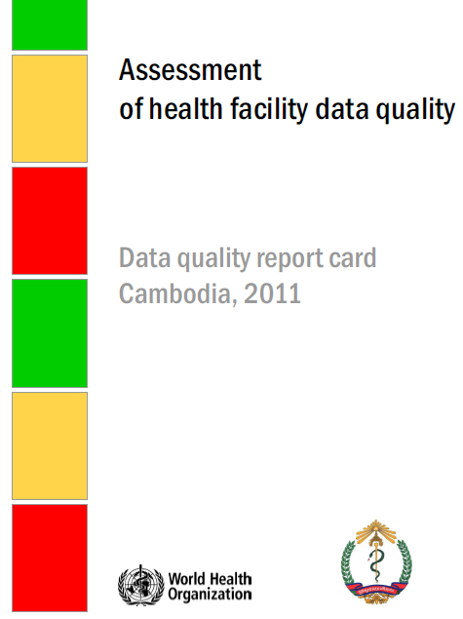
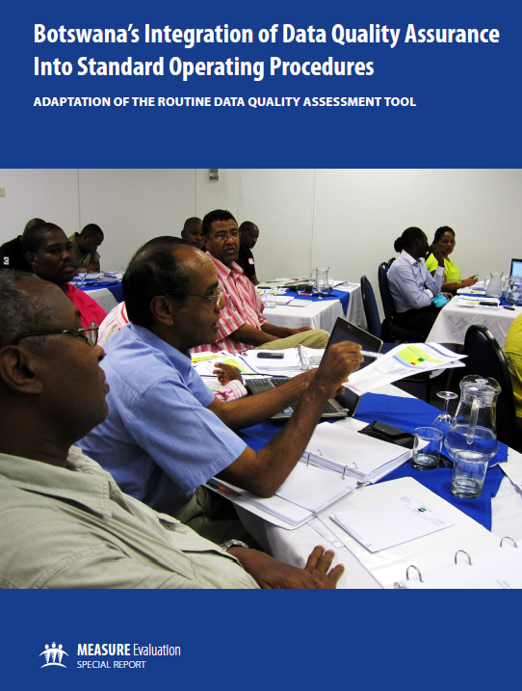
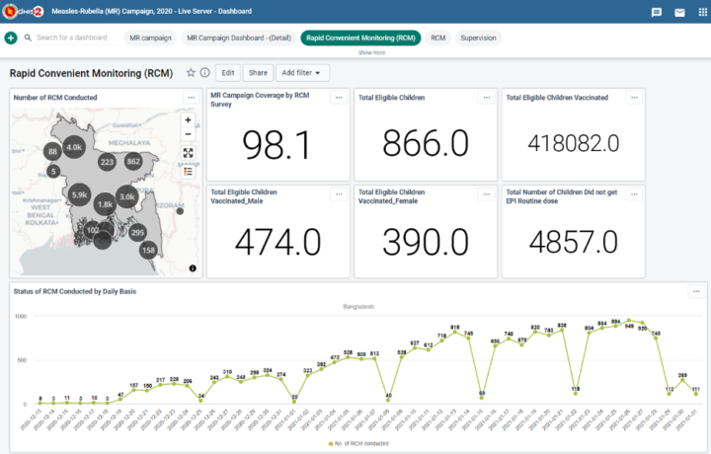
Country-specific documentation
Standards and Tools
Case studies
Best practices
Notes:
Moving on from the folder for global standards and tools, let me present one slide on the other folder.
We have only begun to compile what is perhaps the most important component of the archive: country-specific documentation including countries’ own standards and tools, rich case studies and findings from implementation research and examples of best practice.

Slide 9
Next steps – a work in progress
Needed
Additional documentation and analysis (relevance, gaps, overlaps, etc.)
A brief written guide to the archive
A home for the archive on the web
Public access and announcement
Invite public comment to validate the archive
Periodic additions to the country-specific documentation

Slide 10
Thank you

