Slide 1
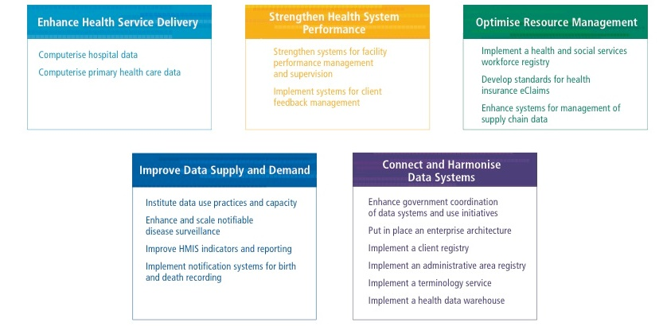
Planned steps and gaps in expertise or investments
“Digital health roadmap – better data for better health” contains 17 investment recommendations grouped into 5 areas.

Slide 2
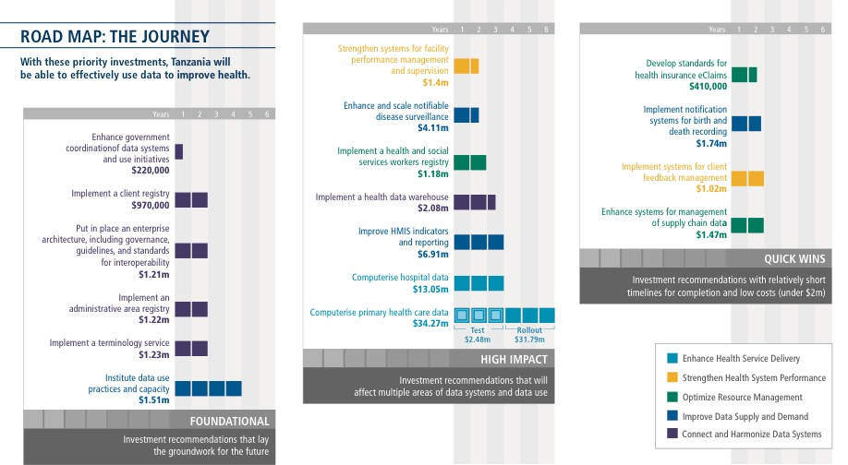
DATA USE PARTNERSHIP

